Slide 1
Decision System for Credit Underwriting
Team Lead: Raja N.
Coordinator: Snehal Tambe
Team Members: Mandar Vast
Jagdish Kharatmol
Parth Sethi
B.V. Sai Harsha

Slide 2
OUTLINE
Introduction
Problem Statement
Objectives
Data Summary
Project Architecture
Exploratory Data Analysis
Univariate
Multivariate
Feature Engineering
Data Preprocessing
Model Building
Model Scores
KS Statistics
Deployment
Business Insights
Actionable Insights
Future Scope

Slide 3














Technology Stack
Spreadsheet
Team Collaboration
Tracking Daily Tasks
Data Processing
Model Execution
Visualization Libraries
Machine Learning
Deployment

Slide 4

What is credit underwriting ?
Underwriting is the process by which the lender decides whether an applicant is creditworthy and should receive a loan.
An effective underwriting and loan approval process is a key predecessor to favourable portfolio quality, and a main task of the function is to avoid as many undue risks as possible.

Slide 5
Problem Statement
Credit Karma wants to appraise their potential customer for a loan to scale their lending portfolio.
Strong underwriting is very critical for reducing the risk and for growing their portfolio and hence, a data driven decision is important for the business.
The Current underwriting is manual and standard rules laid by experts, which is time consuming, general and prone to human errors and bias.
Our aim is to develop a scientifically developed driven system to automate decisions and processing for stronger and quicker underwriting.
Objectives
To Explore and analyze the data.
To drive business insights that will help the management to make better decisions.
To develop a machine learning model that will lower the risk for the loan lenders.

Slide 6
Data Summary
Current Applications.csv
Current Applications | No of Columns | 122
 | No of Rows | 3,07,511
Previous Applications | No of Columns | 37
 | No of Rows | 16,70,214
Complete Dataset
Previous Applications.csv
Our Datasets consisted of Client’s Financial data, Credit Scores from 3 different Credit Bureaus, Flags for various Contact info, Flags for Documents submitted, applicant’s Property info, etc.
We didn’t have any of the Transaction data.
Dataset’s Source : https://www.kaggle.com/c/home-credit-default-risk/data
Notes:
Contact info like phone number, email, home phone number, work phone number

Slide 7
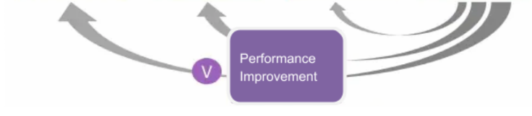
Project Architecture
Exploratory Data Analysis
Exploratory Data Analysis
Feature Engineering
Feature Engineering
Feature Engineering
Data Preprocessing
Data Preprocessing
Data Modeling
Data Modeling
Model Evaluation
Model Deployment
Performance Improvement

Slide 8
Exploratory Data Analysis
UNIVARIATE

Slide 9
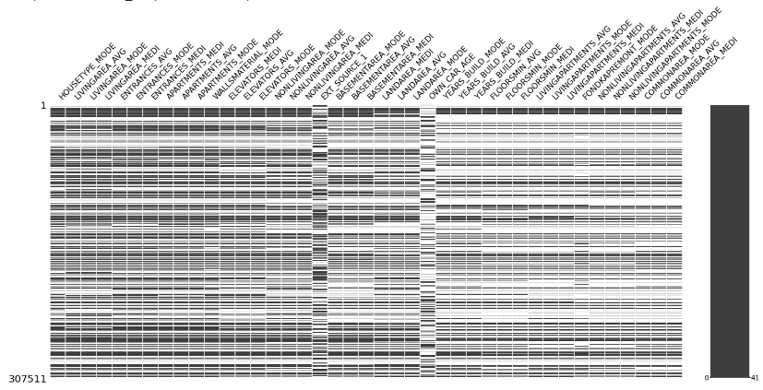
Null values distribution
On the x-axis we have “SK_ID_CURR” and y-axis we have all the features with more than 50% of nan values.
Notes:
It is very significant that the nan values are evenly distributed.

Slide 10
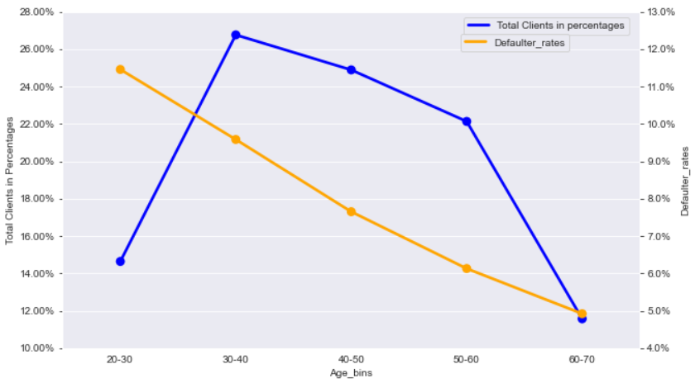
Age distribution w.r.t Target
Total Clients in Percentages
Defaulter rates
Age Bins
Age group 40-50 don't have the highest number of clients but still has substantial no of clients and has a significantly lower default rate at around 7.6%.
Similarly Age group 50-60 has a high number of clients but relatively lower default rate at 6%.
Notes:
27% of our clients are aged 30-40 with a risk of 9.5%.
Plot points
So, we can say that age groups 30-40 and 40-50 are most profitable.

Slide 11
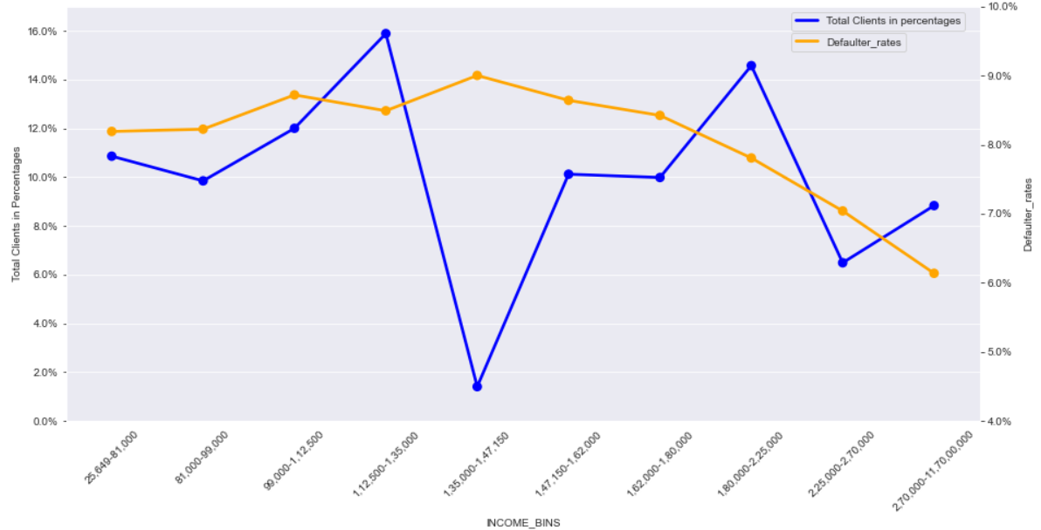
Income Distribution
Total Clients in Percentages
Defaulter rates
Income Bins
16% of our clients have an income of 1,12,000-1,35,000 INR per Annum with a high defaulter rate of 8.5%.
Whereas, we have slightly lower number of clients with an income of 1,80,000-2,25,000 INR per annum but they have comparatively lower defaulter rate at 7.8%.
8.8% of our clients have an income of 2,70,000-11,70,00,000 INR per annum but have a very low defaulter rate at 6.1%

Slide 12
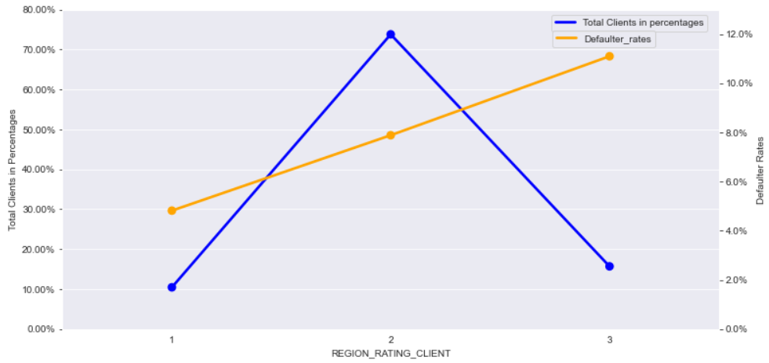
Ratings for region where client lives
Total Clients in Percentages
Defaulter Rates
Region Rating Client
Highest number of our clients are from Regions with rating 2 at 74% but they have a lower default rate at 7.8%.
We have a lower number of clients from regions with rating 3 but their default rate is lot higher at 11.1%.
10% of our clients are from regions with rating 1 and they have the lowest rate at 4.8%.

Slide 13
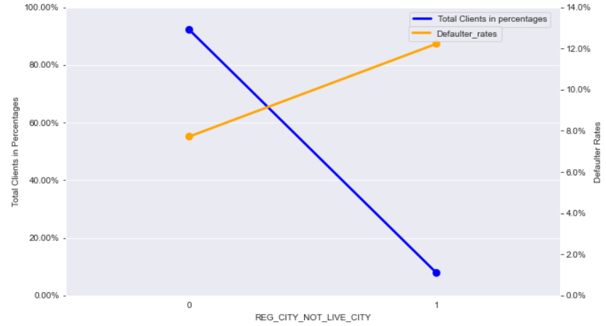
If client’s permanent address does not match contact address(at city level)
Total Clients in Percentages
Defaulter Rates
Reg city not live city
0 is for if addresses are same, 1 is for if addresses are different.
92% of our clients have a same permanent city address and contact address but they have lower default rates at 7.7.%.
Although we have a lower number Clients with a different permanent address and contact address, their default rate is much higher at 12.3%.

Slide 14
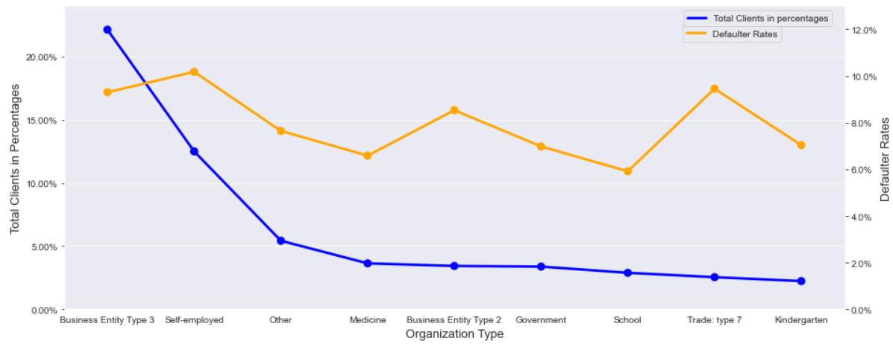
Organization type
22% of our clients are from Business Entity Type 3 with a high defaulter rate at 9.3%.
There are relatively lower number of clients who are Self Employed but have the highest default rate at 10.1%

Slide 15
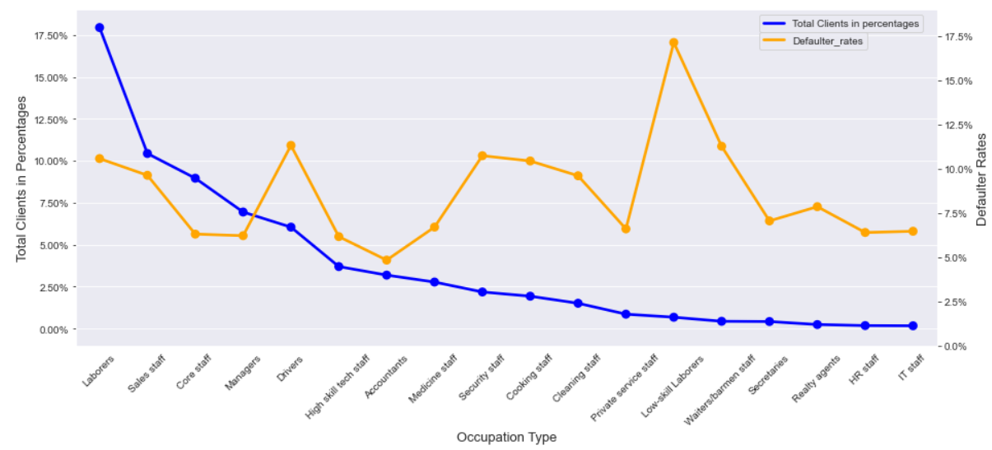
Top occupation types
Around 18% of our clients are Laborers with a risk of 10.6%.
Core staff and Managers have comparatively much lower defaulter rate at around 6% but they combined account to only 16% of our total clients.
Low skill Laborers have the highest defaulter rates at 17%.

Slide 16
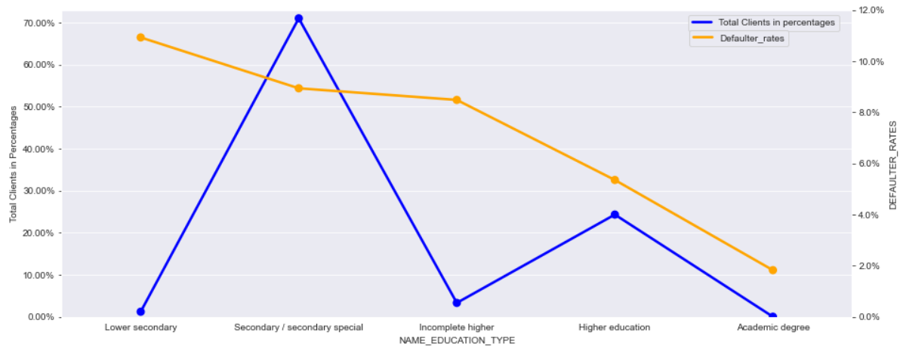
Education type of clients
Total Clients in Percentages
Defaulter Rates
Education Type
Even though we have lower number of clients from Incomplete higher at 3.3% , they have a high defaulter rate of 8.5%.
71% of our Clients are Secondary/ Secondary special graduates with a higher risk of 8.9%.
Even though we have a higher number of clients with higher education as compared to Incomplete higher, their default rate is a lot lower.

Slide 17
Exploratory Data Analysis
MULTIVARIATE

Slide 18
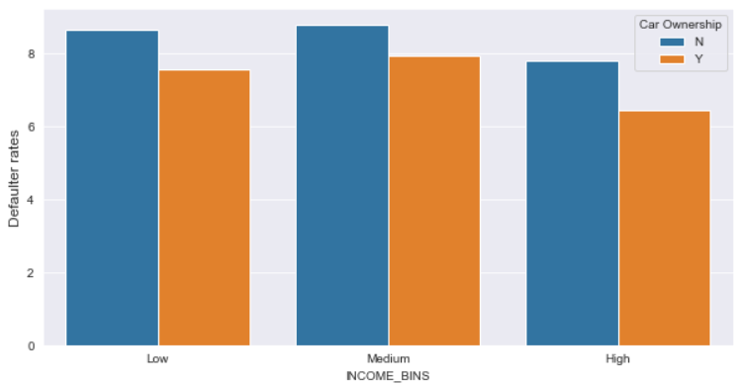
Client’s income w.r.t if they own a car
- Clients of all income group have a higher defaulter rate if they don’t own a car

Slide 19
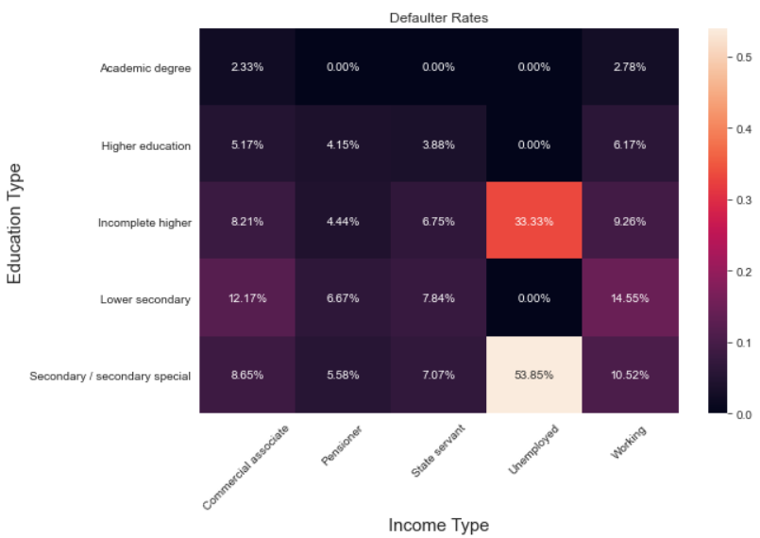
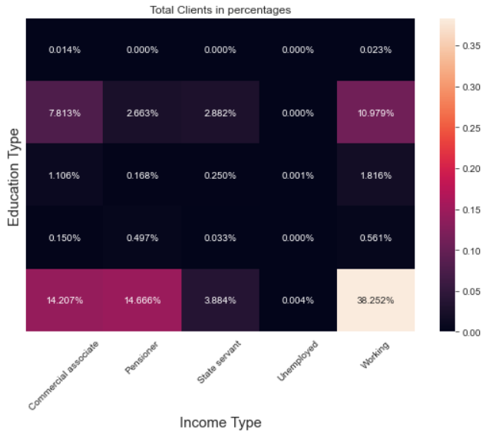
Education type w.r.t income type
38% of our clients are from Working class who are Secondary/ Secondary special graduates but they have a high risk of 10.5%.
We have a slightly lower number of clients of Pensioner class who are Secondary/ Secondary special graduates at 14.6% but their default rate is very low at just 5.58%.
Similarly for Working clients with Higher education and Commercial Associate with Secondary Education, they have a lower default rate as compared to Working class with Secondary Education.

Slide 20
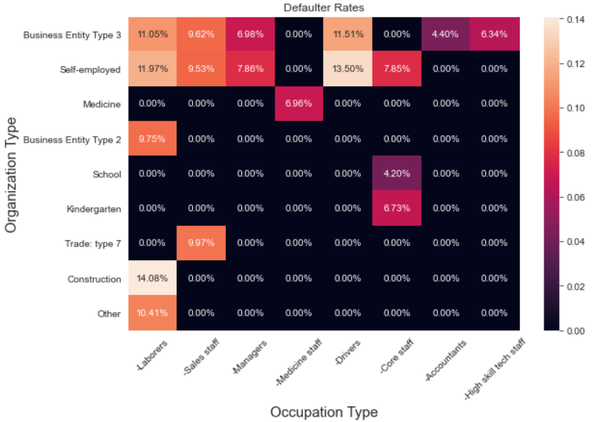
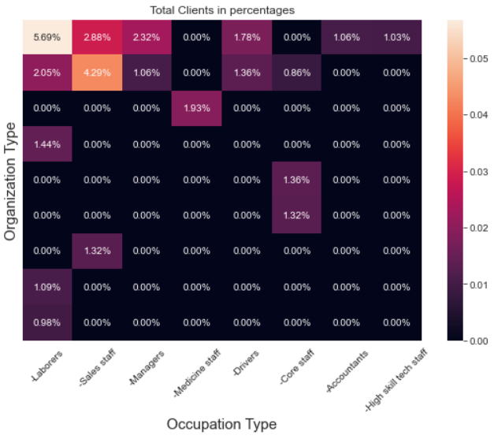
Organization type w.r.t Occupation type for highest frequency types
5.7% of our Clients are Laborers from Business Entity type 3 and they have the highest defaulter rate at 11%.
Followed by Sales Staff who are Self Employed or are from Business Entity type 3 who are also in higher numbers (4.3% and 2.9%) and also have a high defaulter rate at 9.5% and 9.6% respectively.
So we should focus less on these types of clients and change our collection strategies for the same.

Slide 21
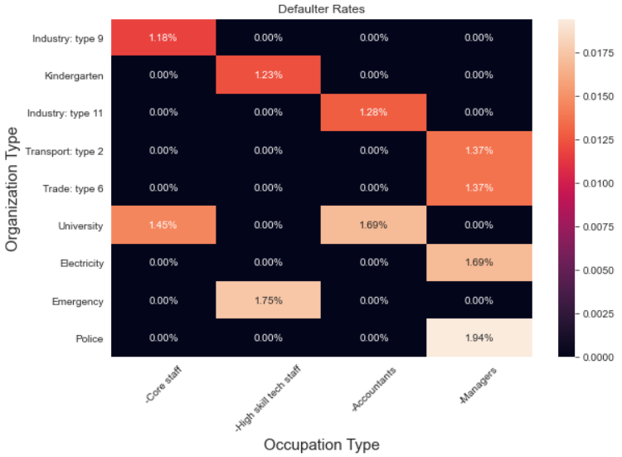
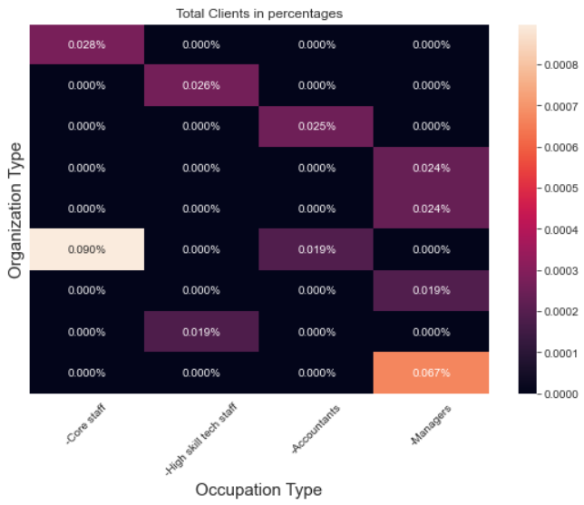
Organization type w.r.t Occupation type for low default rate types
Core Staff from Industry type 9 have the lowest defaulter rate at 1.176% followed by High Skill Tech Staff from Kindergarten and Accountants from Industry type 11 at 1.235% and 1.282% respectively followed by Managers from Transport type2 at 1.370%
But all of these top 10 combined only contribute to 0.34% of the total Clients.
So we should focus on bringing more clients from these organizations and with these occupations.

Slide 22
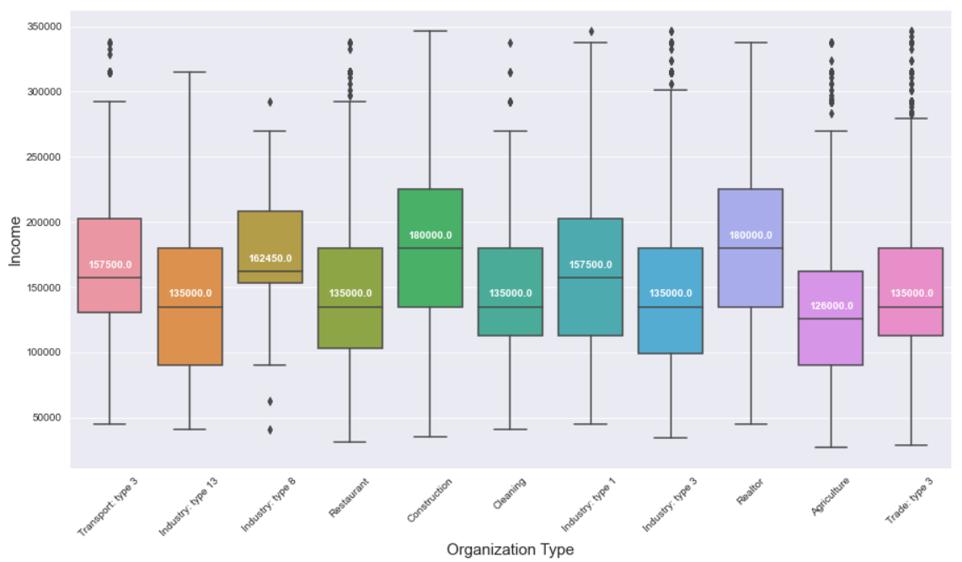
Distribution of Income w.r.t Organization types for Low Defaulter rate types
Medians are below or around 1,50,000.

Slide 23
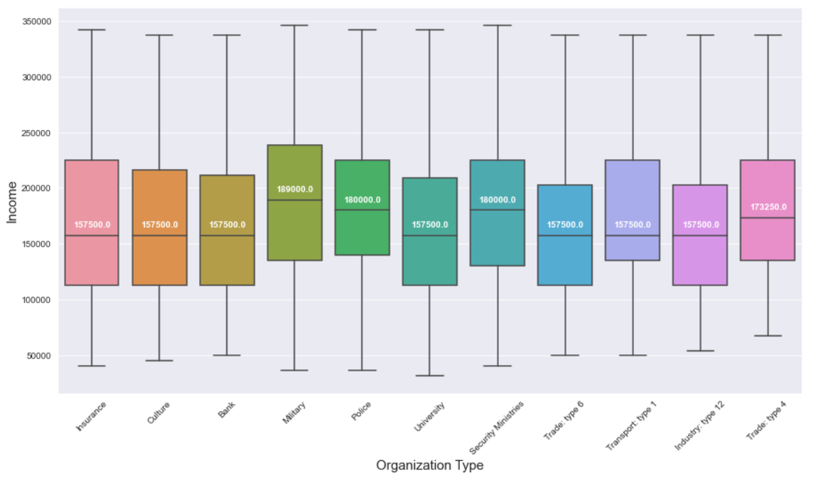
Distribution of Income w.r.t Organization types for High Defaulter rate types
The Clients from organization type with highest defaulters have a lower income average of 1,57,509 as compared to 1,74,427 income average of clients from organization type of lowest defaulters with a difference of 17,000 between them.
Notes:
Medians are above 1,50,000

Slide 24
FEATURE ENGINEERING
Important features derived from feature engineering are:
Number of Previous Applications: No of previous applications of the current applicants.
Credit to Income Ratio: Ratio of Credit amount to Income amount.
Annuity to Income Ratio: Ratio of Annuity amount to Income amount.
Goods Price to Income: Ratio of Goods Price to Income amount.
No of Documents Submitted: Total No of Documents submitted out of the total 20 documents.
Source Scores Average: Average of External Score 1, External Score 2, External Score 3.
Asset Index: Index of the assets owned by applicant (Income, Property, Car).
Contact Info: Total number of contacts provided by applicants (Mobile number, Work phone number, home phone number, Email).
K means clusters: Segregated data in 3 clusters based on elbow method and added their cluster number as a new column.

Slide 25
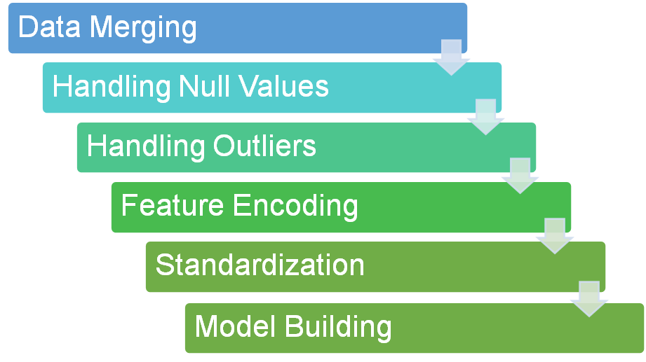
DATA PREPROCESSING
Notes:
Merged two datasets
Dropped columns having more than 47% null values.
For columns having 5.35% to 47% null values, mean imputed continuous variables and mode imputed categorical ones.
Reduced rows from columns having less than 5.35% null values
Reduced classes for column having more than 10 classes to 10.
Label Encoded ordinal columns and applied one hot encoding on nominal columns.
Standardized continuous variables.
Trained and validated models.

Slide 26

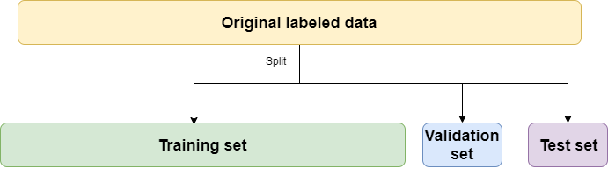
MODEL BUILDING
We split the data into Train, Validation and Test sets.
We have used both K-Fold and Stratified K-Fold cross validation.
Is a variation of K-Fold which returns stratified folds.
Stratified folds : Each set contains approximately the same percentage of samples from each target class.

Slide 27
MODEL SCORES
Model | Accuracy | F1 Score | Recall | KS
Logistic Regression | 92.4 | 0.88 | 0.92 | 37.27%
Random Forest Classifier | 91.75 | 0.0036 | 0.001823 | 31.91%
Ada Boost | 91.89 | 0.0547 | 0.0288 | 35.70%
Gradient Boost | 91.93 | 0.0348 | 0.0179 | 37.05%
XGBoost | 91.88 | 0.01025 | 0.0051 | 37.44%
LightGBM | 91.90 | 0.04434 | 0.02309 | 37.96%

Slide 28
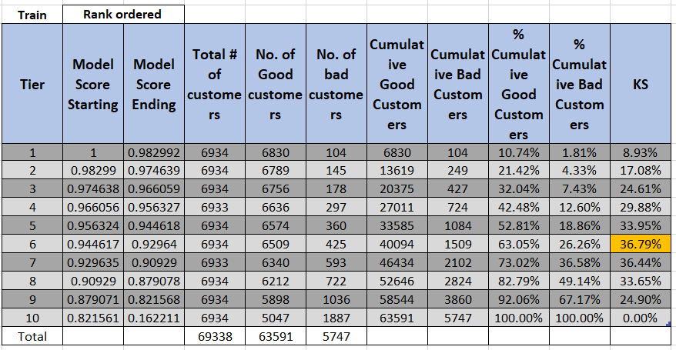
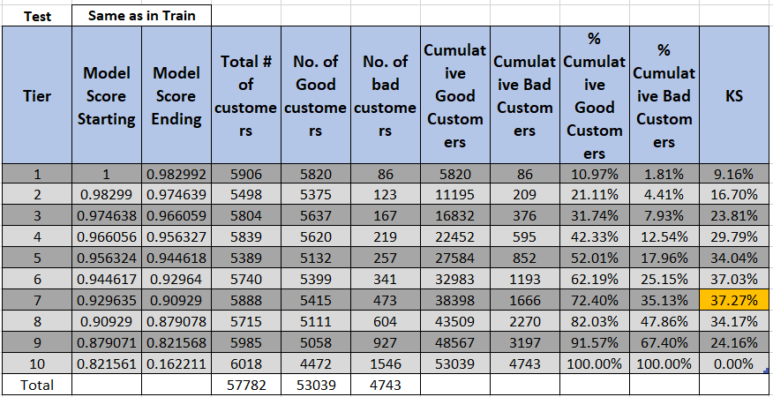
Kolmogorov-Smirnov Statistics For Logistic Regression
KS-test compares the two cumulative distributions and returns the maximum difference between them.
In our case, it compares the cumulative distribution of good customers and bad customers and KS is where there is a maximum difference between the two distributions.
It helps us to understand how well our predictive model is able to distinguish between good and bad customers.

Slide 29
Deployment
Logistic Regression model was used for deployment.
We selected the top 16 variables as input variables.
These top 16 variables were selected using Select KBest with chi square function.
Web interface was built using Bootstrap and Flask.

Slide 30
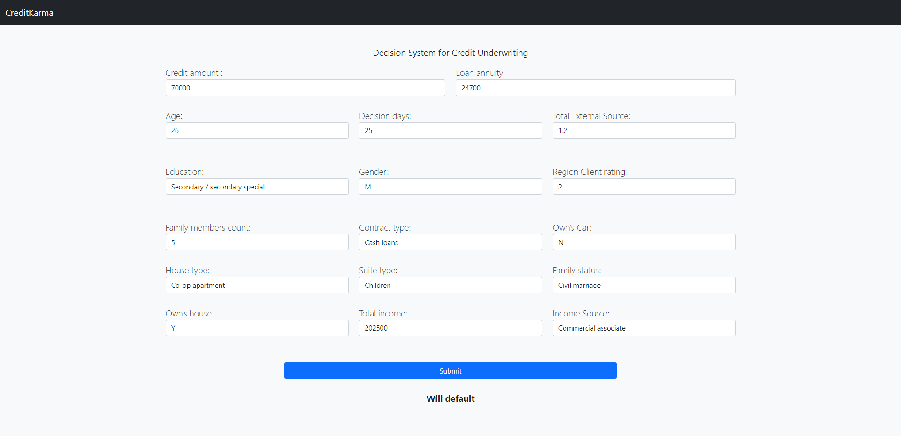
Deployment UI

Slide 31
Business Insights
Age groups 40-50 and 50-60 have a high number of clients at 43% but relatively lower default rates at 6.8%.
Similarly, clients with income of 1,80,000-2,25,000 INR per Annum and 2,70,000-11,70,00,000 INR per Annum have 24% clients with lower defaulter rates at 6.85%.
Highest number of our clients are from Regions with rating 2 with 74% but with a low default rate at 7.8%. Whereas, we have a lower number of clients from regions with rating 3 with 15% but their defaulter rate is a lot higher at 11.1%.
Clients who have a different permanent address and contact address have a higher defaulter rate at 12.3%.
Low skill laborers have a very high defaulter rate at 17%. Whereas, Core staff and managers have a comparatively much lower defaulter rate at 6% but they combined account to only 16% of our total clients.

Slide 32
Business Insights Part 2
Even though we have a higher number of clients with higher education at 25% as compared to Incomplete higher with 3.3%, their default rate is a lot lower at 5.2% compared to 8.5% for Incomplete Higher.
We have a high number of Pensioners and Commercial associates with Secondary education at 29% as well as Working class with Higher Education clients with 11% but they have very low default rates at an average of 6.7%.
Laborers and Sales staff from Business Entity type 3 have high defaulter rates at 11% and 9.6% respectively.

Slide 33
Actionable Insights
Marketing team
Increase clients from age groups like 40-50 and 50-60 and clients with income between 1,80,000-2,25,000 INR per Annum and 2,70,000-11,70,00,000 INR per Annum as these groups have very low defaulter rate but the number of clients is also low.
Similarly, add more clients who are Pensioners and Commercial Associates with Secondary/Special Secondary Education and Working clients with Higher education.
Operational team
Differential Pricing plans based on various customer characteristics like if the clients have a different permanent address and client address or not, client’s age, income, etc.
Change collection strategies for clients coming from Region type 3, clients from Business Entity 3 organization type and clients with Incomplete Higher Education as these groups have high defaulter rates. Specifically for Laborers and Sales Staff from Business Entity type 3.

Slide 34
Future Scope
❑ We can try to collect more data like the applicant’s transaction data which will further improve our model’s performance.
❑ We can try to do more Data Analysis and Feature Engineering.
❑ We can try to solve the problem using Neural Nets.

Slide 35
QUESTIONS?

Slide 36
THANK YOU

Slide 37
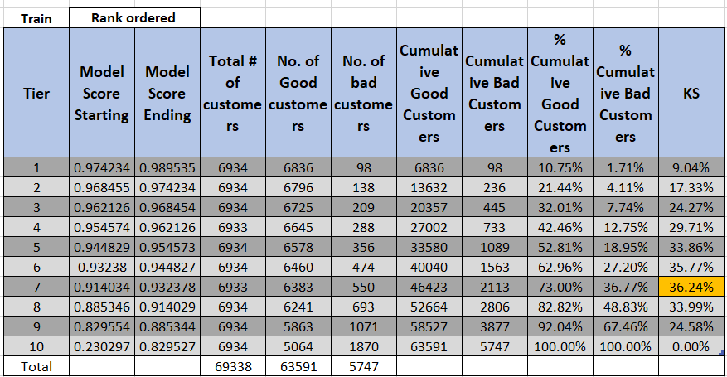
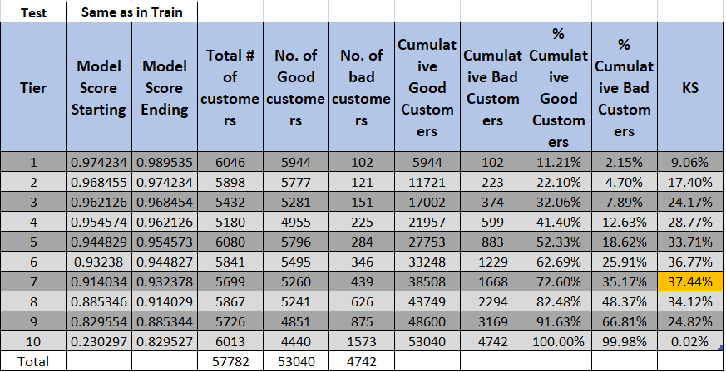
KS statistics for gradient boost

Slide 38
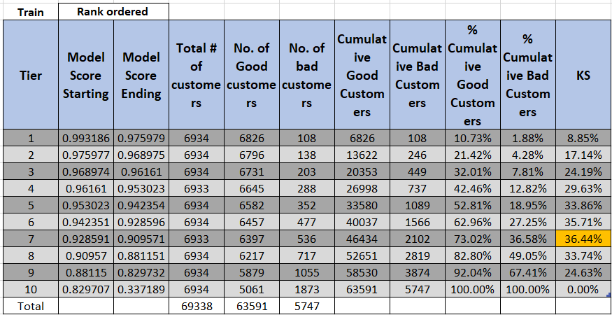
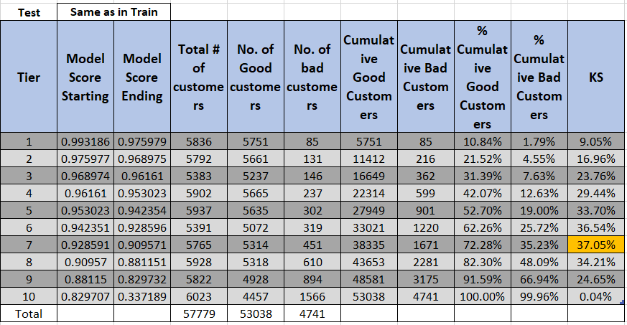
KS statistics for Xtreme gradient boost

Slide 39
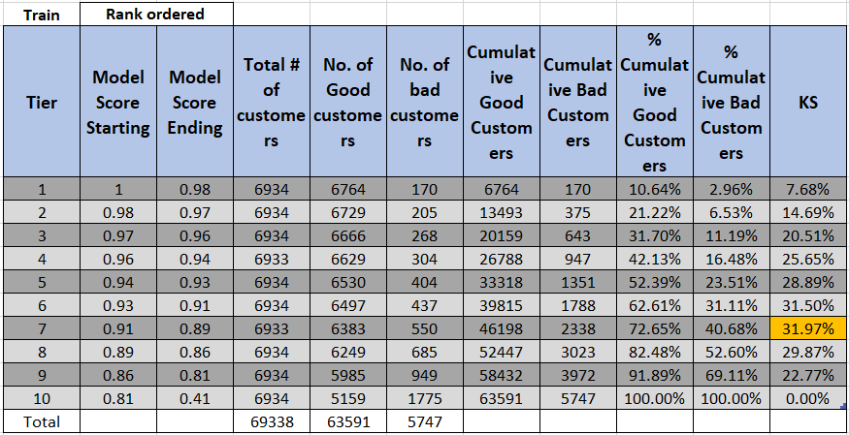
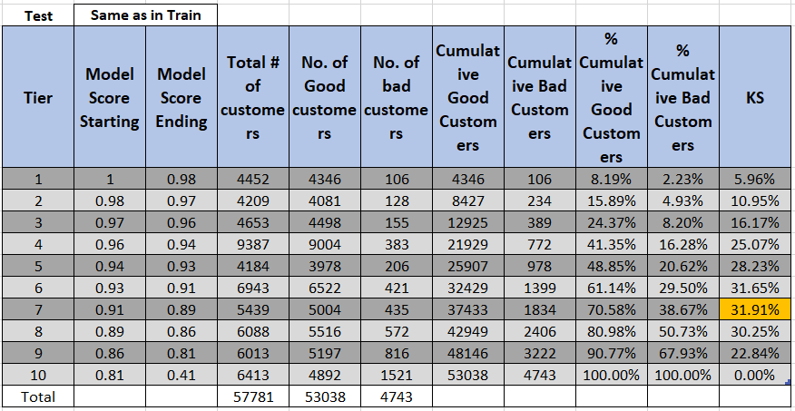
KS statistics for Random Forest

Slide 40
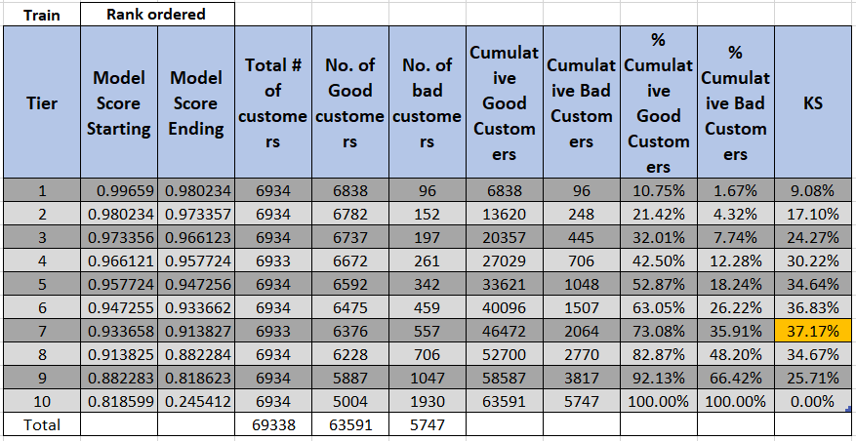
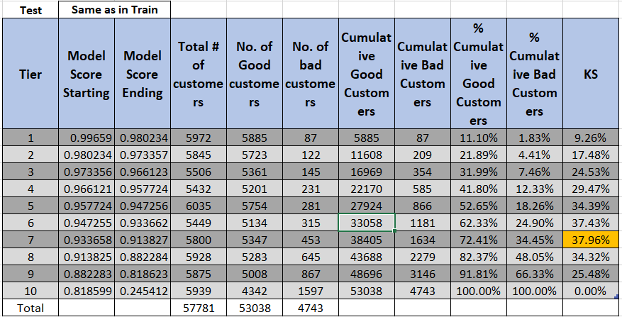
KS statistics for Light GBM

Slide 41
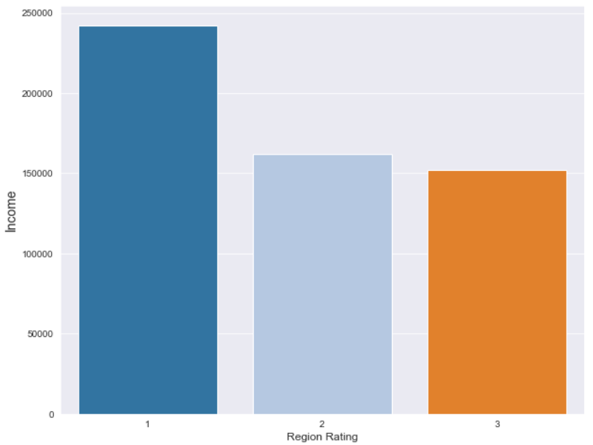
Region Rating w.r.t Income

Slide 42
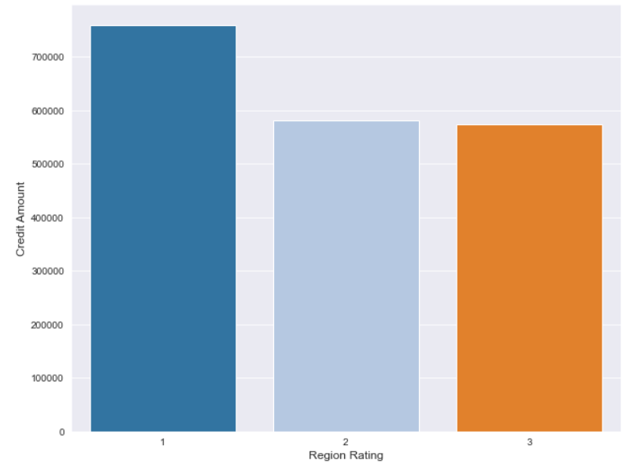
Region Rating w.r.t Credit Amount

Slide 43
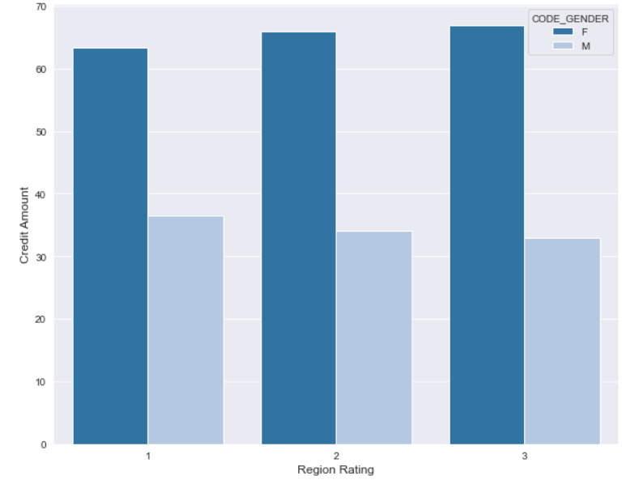
Region Rating w.r.t Gender
Total Clients in Percentages

